Slide 1
Javascript

Slide 2
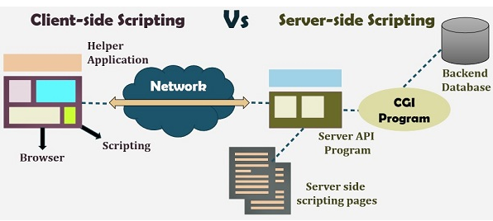
Client side scripting vs Server side scripting

Slide 3
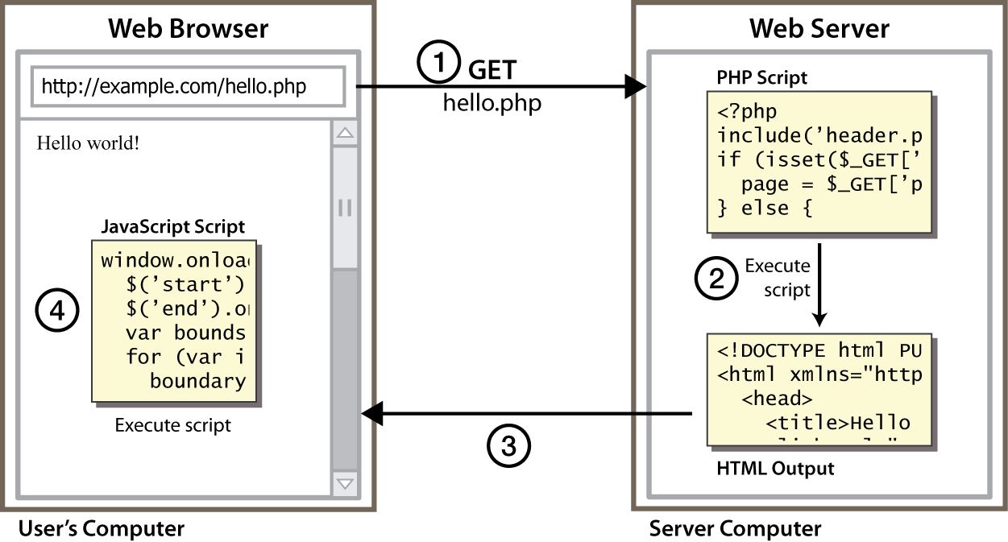
Client Side Scripting
Notes:
client-side script: code runs in browser after page is sent back from server
often this code manipulates the page or responds to user actions

Slide 4
Why use client-side programming?
PHP already allows us to create dynamic web pages. Why also use client-side scripting?
client-side scripting (JavaScript) benefits:
usability: can modify a page without having to post back to the server (faster UI)
efficiency: can make small, quick changes to page without waiting for server
event-driven: can respond to user actions like clicks and key presses

Slide 5
Why use client-side programming?
server-side programming (PHP) benefits:
security: has access to server's private data; client can't see source code
compatibility: not subject to browser compatibility issues
power: can write files, open connections to servers, connect to databases, ...

Slide 6
INTRODUCTION
Script is generally a series of program or instruction, which has to be executed on other program or application.
Server side scripting involves server for its processing
Client-side scripting requires browsers to run the scripts on the client machine but does not interact with the server while processing the client-side scripts.

Slide 7
Server-side scripting
The operations like customization of a website, dynamic change in the website content, response generation to the user’s queries, accessing the database, and so on are performed at the server end.
The server-side involves three parts: server, database, API’s and back-end web software developed by the server-side scripting language.
Languages - PHP, Python, Ruby, ColdFusion, C#, Java, C++

Slide 8
Client-side scripting
The client-side scripting can be used to examine the user’s form for the errors before submitting it and for changing the content according to the user input.
Popular client-side scripting languages HTML, CSS and JavaScript.

Slide 9
What is Javascript?
a lightweight programming language ("scripting language")
used to make web pages interactive
insert dynamic text into HTML (ex: user name)
react to events (ex: page load user click)
get information about a user's computer (ex: browser type)
perform calculations on user's computer (ex: form validation)

Slide 10
What is Javascript?
a web standard (but not supported identically by all browsers)
NOT related to Java other than by name and some syntactic similarities

Slide 11
Javascipt
Every collection of javascript code is called script and any number of scripts can be embedded into HTML document.
Makes browser more lively and interactive.
Browsers are responsible for running Javascripts and javascripts runs automatically when the page loads.

Slide 12
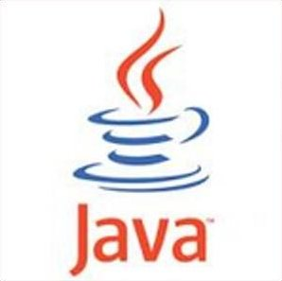
Javascript vs Java
interpreted, not compiled
more relaxed syntax and rules
fewer and "looser" data types
variables don't need to be declared
errors often silent (few exceptions)
key construct is the function rather than the class
"first-class" functions are used in many situations
contained within a web page and integrates with its HTML/CSS content

Slide 13
JavaScript vs. PHP
similarities:
both are interpreted, not compiled
both are relaxed about syntax, rules, and types
both are case-sensitive
both have built-in regular expressions for powerful text processing

Slide 14

JavaScript vs. PHP
Differences:
JS is more object-oriented: noun.verb(), less procedural: verb(noun)
JS focuses on user interfaces and interacting with a document; PHP is geared toward HTML output and file/form processing
JS code runs on the client's browser; PHP code runs on the web server

Slide 15
Tags
<script> tag is used to include javascript codes.
Since many other scripting programs are available, “type” of scripting language has to be mentioned.
Direct reference
<script type=“text/javascript”>
Indirect reference
<script type=“text/javascript” src=“tst_number.js”/>

Slide 16
Java and JavaScript
Differences
JavaScript has a different object model from Java
JavaScript is not strongly typed

Slide 17
VARIABLES
A variable is an identifier for a value.
There are many ways to define the variable in javascript.
the let keyword followed by the name of the variable.
the var keyword followed by the name of the variable.
If variables are declared without any keywords like var and let, then it is declared global.

Slide 18
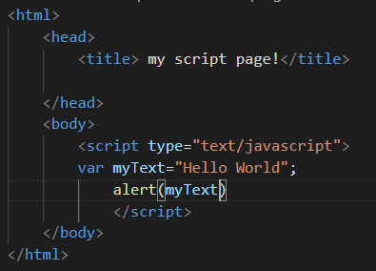
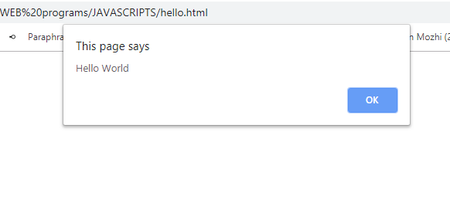
VARIABLES

Slide 19
Naming Variables
Variables should consist characters,it may be one character or as many as you want
Variables can start with a letter,underscore(_),or dollar sign($) character.They can’t start with a number
Spaces are not allowed.

Slide 20
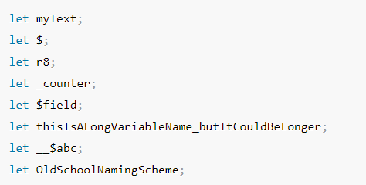
Valid variable names are

Slide 21
Syntax statements
Statements can be terminated with a semicolon
However, the interpreter will insert the semicolon if missing at the end of a line and the statement seems to be complete
If a statement must be continued to a new line, make sure that the first line does not make a complete statement by itself

Slide 22
Primitive Types
Five primitive types
Number
String
Boolean
Undefined
Null
There are five classes corresponding to the five primitive types
Wrapper objects for primitive values
Place for methods and properties relevant to the primitive types
Primitive values are coerced to the wrapper class as necessary, and vice-versa

Slide 23
Numeric and String Literals
Number values are represented internally as double-precision floating-point values
Number literals can be either integer or float
Float values may have a decimal and/or and exponent
A String literal is delimited by either single or double quotes
There is no difference between single and double quotes
Certain characters may be escaped in strings
\’ or \” to use a quote in a string delimited by the same quotes
\\ to use a literal backspace
The empty string ‘’ or “” has no characters

Slide 24
Other Primitive Types
Null
A single value, null
null is a reserved word
A variable that is used but has not been declared nor been assigned a value has a null value
Using a null value usually causes an error
Undefined
A single value, undefined
However, undefined is not, itself, a reserved word
The value of a variable that is declared but not assigned a value
Boolean
Two values: true and false

Slide 25
The typeof Operator**
Returns “number” or “string” or “boolean” for primitive types
Returns “object” for an object or null
Two syntactic forms
typeof x
typeof(x)

Slide 26
Constant variable
In javascript any variable can be changed to any values.
Constant variables are declared in order not to change the value.
const keyword is used for declaration

Slide 27
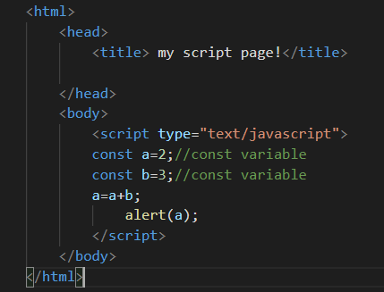
This program wont give any output since we are trying to change the value of const variable.

